Slide 1

第七课
yín
háng
zài
nǎr
请问，银行在哪儿

Slide 2
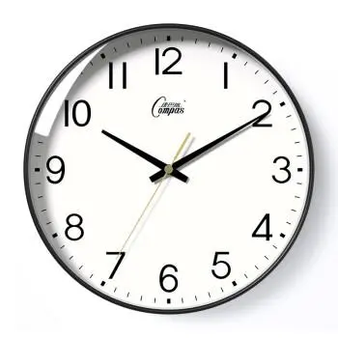
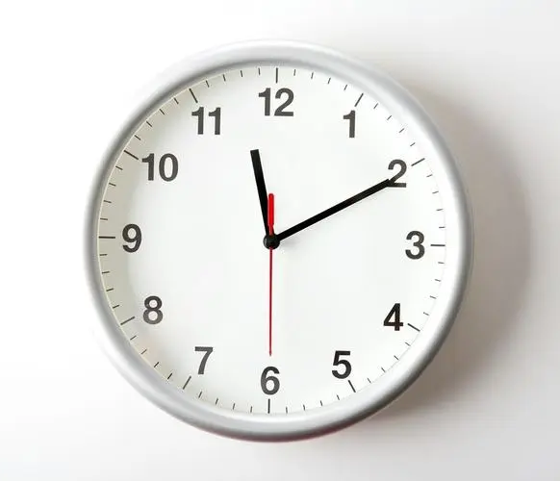
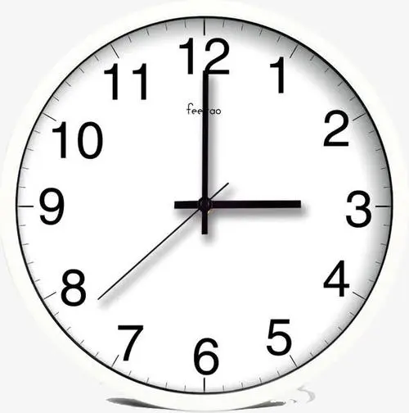
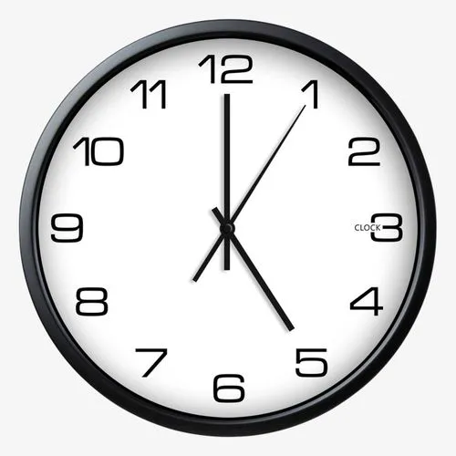
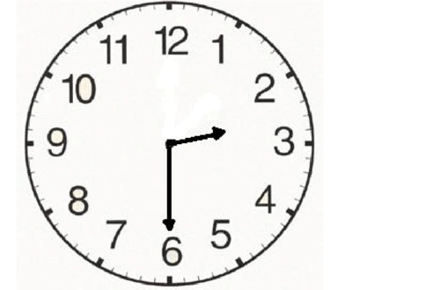
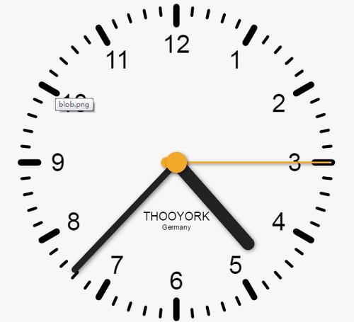



现在几点？
现在10点10分
现在11点10分
现在3点
现在4点37分
现在5点
现在两点半

Slide 3



注意：
当“分”为0或30的时候，不说“分”
例：3:00（3点）
3:30（3点半）
15:00（15点）
15:30（15点半）

Slide 4
生词
New words
zài
Nǎr=nǎ er
dì fang
在
哪儿
东边
西边
南边
北边
前边
后边
where
地方
学校
书店
银行
宿舍
楼
那
座
号
place
(located) at
xué xiào
dōng bian
school
eastern part
shū diàn
xī bian
Book store
western part
yín háng
nán bian
bank
southern part
sù shè
běi bian
domitory
northern part
lóu
qián bian
storied building
the front side
nà
there/that
hòu bian
zuò
behind
classifier for buildings, mountains and similar immovable objects
不客气
hào
ordinal number
bú kè qì

Slide 5






楼
lóu
yí zuò
一座楼
这座楼
那座楼
哪座楼？
A building
zhè
this building
nà
that building
nǎ
which building

Slide 6

楼 lóu building
楼层lóucéng〖storey; floor〗
楼道lóudào〖passageway〗
楼上lóushàng〖upstairs〗
上楼shànglóu〖go upstairs〗
楼梯lóutī〖stair〗
noun
verb+noun

Slide 7
楼 lóu
你在哪里？
我在楼上的教室里。
Nǐ zài nǎlǐ?
Wǒ zài lóu shàng de jiàoshì lǐ.
where are you?
I'm in the classroom upstairs.

Slide 8




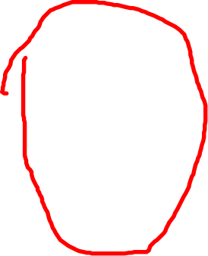
这 zhè
这次zhècì〖this time〗
这个zhège〖this〗
这么zhème〖so〗∶指示程度、方式、性质等(Indicating the degree, method, nature, etc.)
Eg: 这口井这么深啊! This well is so deep!
zhè kǒu jǐng zhème shēn a!
这个时候 zhège shíhòu〖at this time〗

Slide 9




号 hào
号称 hàochēng〖be known as〗 四川号称天府之国。
(Sichuan is known as the land of abundance.)
号角 hàojiǎo〖horn〗
号令 hàolìng〖order〗 听我号令。(Pay attention to my orders.)
号码 hàomǎ〖number〗你的电话号码是多少？(What is your telephone number?)
号召 hào zhào〖appeal/call on〗老师号召大学生积极学习。
(Teacher calls on college students to study actively. )
记号 jìhào〖mark〗在书上做记号。(Make a mark on the book. )

Slide 10






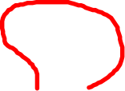


号 hào háo
号叫 háo jiào〖howl; yell〗对天号叫。Yelling at the sky
号啕 háotáo〖cry loudly〗号啕大哭 Háotáodàkū

Slide 11




那 nà
那个nà ge〖that〗那一个,也指那种事物
Refers to a people or thing that is far away
Eg: nàgè gōngyuán de huāmù hěn bùcuò.
那个公园的花木很不错。
The flowers and trees in that park are very good.
2. 那些nà xiē〖those〗 Refers to two or more people or things that are far away Eg:Wǒ rènshí cháguǎn lǐ nàxiē rén.
我认识茶馆里那些人。
I know those people in the teahouse.

Slide 12






那 nà
3.那里，那儿nà li, nàr〖at that place〗 Refers to a certain place (such as a house, etc.), which
generally must be restricted by nouns or pronouns before it. Eg: Xiǎomíng yāoqǐng wǒmen wǎnshàng dào tā nàlǐ qù.
小明邀请我们晚上到他那里去.
Xiao Ming invited us to him at night.
4.那么nà me〖then〗
means to follow the meaning of the above and lead to the expected result eg:tā jìrán bù láile, nàme wǒ yě huíqùle
他既然不来了,那么我也回去了。 Since he is not coming, then I will go back too .

Slide 13









哪 nǎ
哪儿 nǎr〖where〗 e.g. 超市在哪儿？Where is the supermarket?
你去哪儿？Where do you go?
哪个 nǎge〖what;which〗∶所指事物中的哪一个
你们是哪个班的? Nǐmen shì nǎge bān de?Which class are you in? 〖who〗∶哪个人;谁
哪个人在打电话？Nǎge zài dǎ diànhuà?Who is calling?

Slide 14






地方
dì fang
space; region; area; place
你是什么地方的人? Which area do you come from?
教室里人都坐满了，没有地方了。
The classroom is full of people and there is no place.
我这个地方有点疼。 I have a little pain in this place.
这是什么地方？ What is this place?

Slide 15




座zuò
座位zuòwèi〖seat;place〗
从座位上站起来。Get up from your seat.
坐在你的座位上。Sit down on your seat.
Classifier 量词，多用于较大或固定的物体（Mostly used for larger or fixed objects）
一座山 a mountain
一座楼 a building

Slide 16



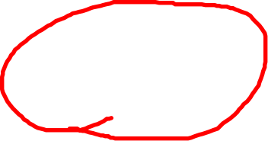



客气
客气
不客气
Very modest; courteous; polite
A：谢谢！
B：不谢！
A：谢谢！
B：不用谢！
A：谢谢！
B：不客气！

Slide 17
xué xiào
shū diàn
school
Book store
yín háng
sù shè
bank
domitory

Slide 18
direction NP
dōng bian
xī bian
eastern part
western part
nán bian
běi bian
southern part
northern part

Slide 19




语言点 Language Points
N
银行在哪儿？
Where is the bank?
银行在东边。
The bank is in the eastern part.
东

Slide 20

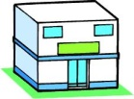
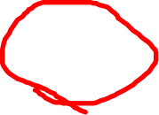

语言点 Language Points
N
银行在哪儿？
Where is the bank?
银行在书店(的)东边。
The bank is to the east of the bookstore.
东

Slide 21

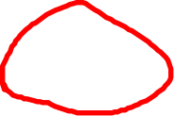
语言点 Language Points
sb./sth. + 在 + place/direction NP
Person/Thing Existing | Located at | Place/Direction NP
银行 | 在 | 东边。
银行 | 在 | 书店（的）东边。

Slide 22
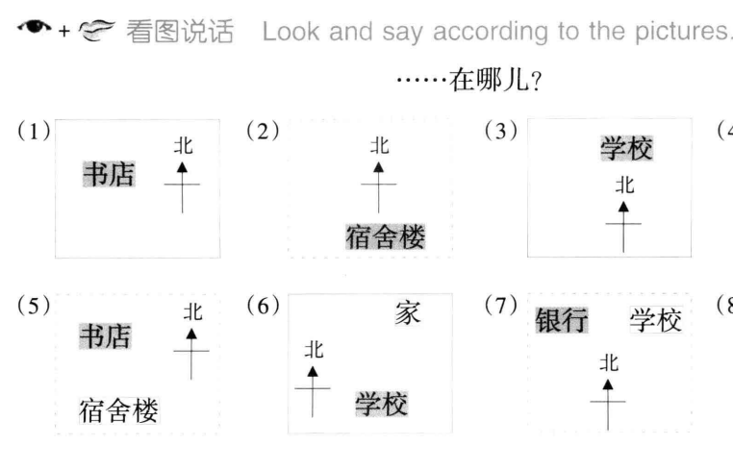



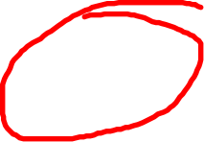


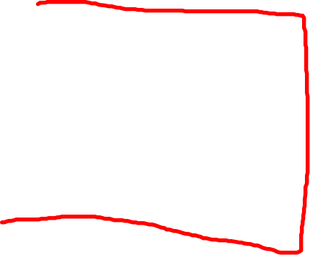

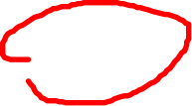
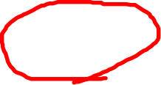

Slide 23

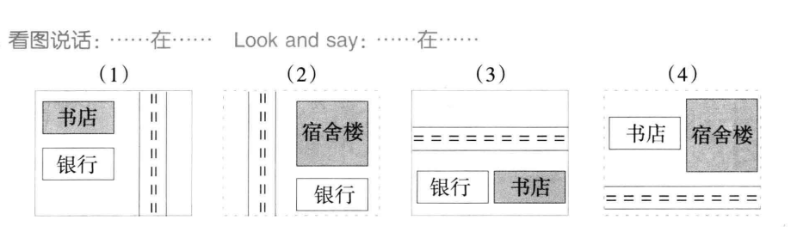

Slide 24
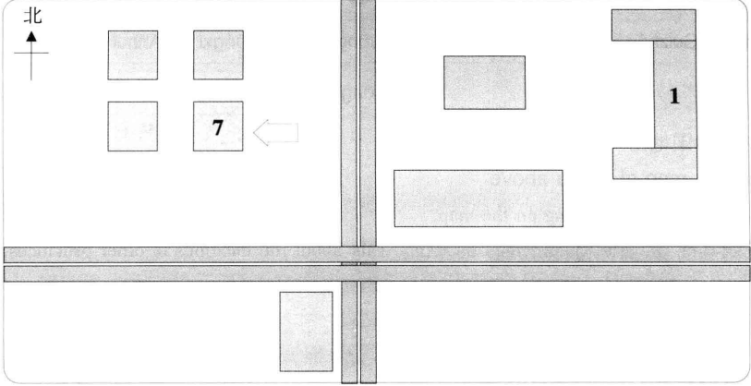
Read the short text and locate the correct place of the following places and mark them on the map.
书店 银行 2号楼 6号楼
书店在7号楼北边，银行在书店西边，
7号楼在6号楼东边，2号楼在1号楼西边.

Slide 25
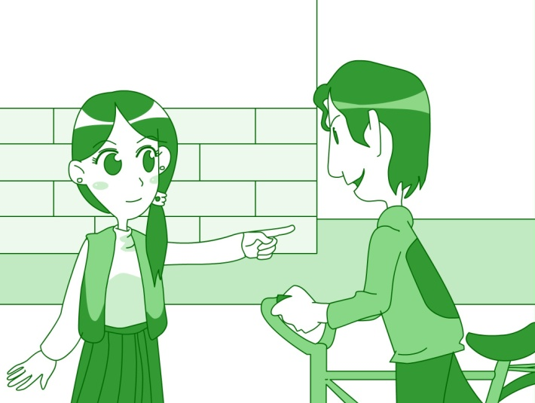
课文 Texts（一）
北
？

Slide 26
朗读课文
路人：请问，银行在哪儿？
林月：银行在东边。
路人：这是什么地方？哪座楼是银行？
What is this place? Which building is the bank.
林月：这是书店，东边的那座楼是银行。
This is the bookstore. The building to the East is the bank.
路人：谢谢！
林月：不客气！

Slide 27
哪座楼是银行？ 银行是哪座楼？
东边的那座楼是银行。
银行是东边的那座楼。

